Slide 1
Shading Models

Slide 2
3D Viewing Pipeline
Primitives
Object space
Modeling Transformation
World space
Viewing Transformation
Camera space
Hidden Surface Removal
Lighting & Shading
3D-Clipping
Projection
Normalized view space
Scan conversion, Hiding
Image space, Device coordinates
*
Computer Graphics
‹#›
Image
Notes:
‹#›

Slide 3
Viewing Models
Need for different models
Light Models: To take care of Light, its intensity and effect on different textures.
Shading Models: To take care of type of surface – its shape, texture etc. and rendering the intensity at every point of the surface.
Colour Models: Various colour schemes present to represent the calculated intensities on your computer.
*
Computer Graphics
‹#›

Slide 4
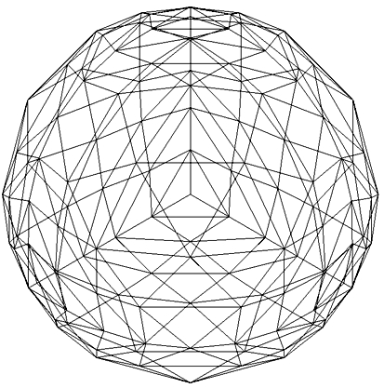
Shading Models
Shading Models: We have an illumination model for given point on a surface and every point on the surface is unique.
Should we calculate intensity of light at all points of the object?
If our surface is defined as mesh of polygons, which point should be used?
*
Computer Graphics
‹#›

Slide 5
Shading Models
Keep in mind:
It’s a fairly expensive calculation
Several possible answers, each with different implications for the visual quality of the result
Three common techniques are
Constant shading (No Shading)
Faceted shading
Gouraud shading
Phong shading
Shading models dictate how often the color computation is performed.
*
Computer Graphics
‹#›

Slide 6
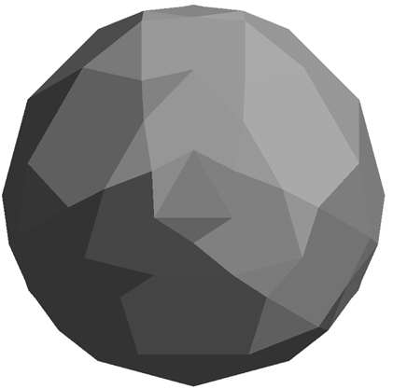
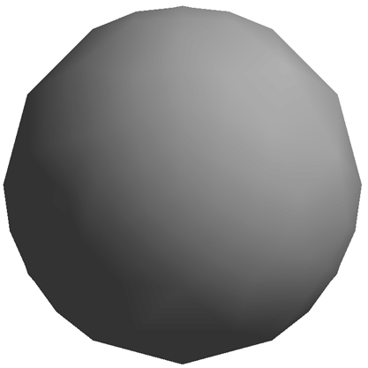
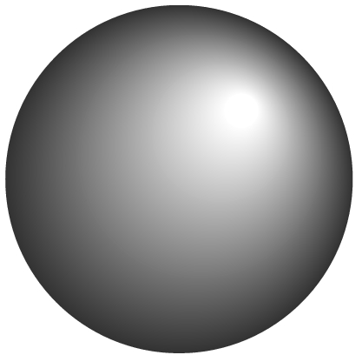
SHADING METHODS
POLYGON RENDERING METHODS
FACETED SHADING
Is used for objects defined as polyhedral.
INTERPOLATION SHADING
Used for polyhedron-mesh approximation of curved surfaces
CONSTANT SHADING
No Shading
GOURAUD SHADING
Interpolate intensity
PHONG SHADING
Interpolate surface normal
*
Computer Graphics
‹#›

Slide 7
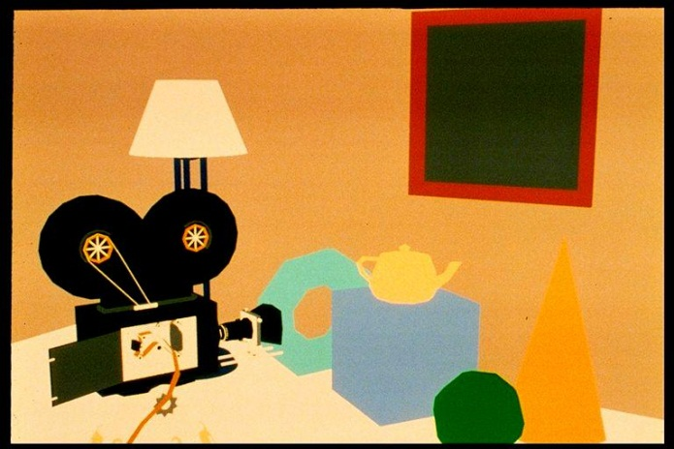
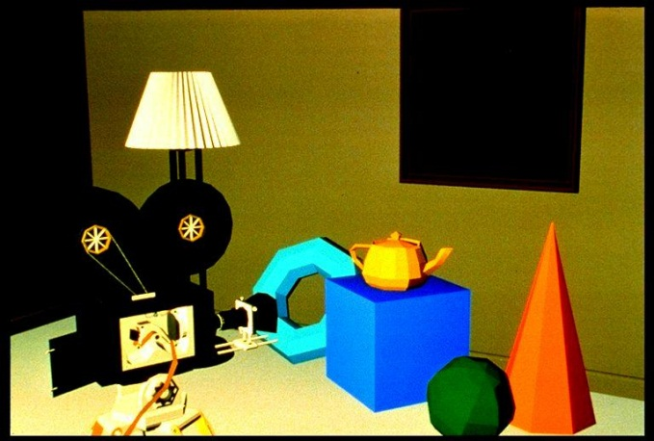
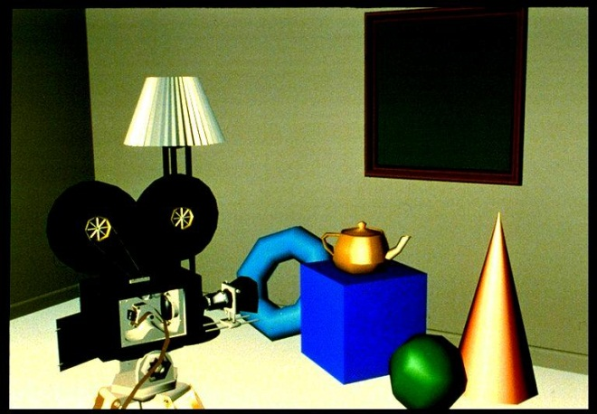
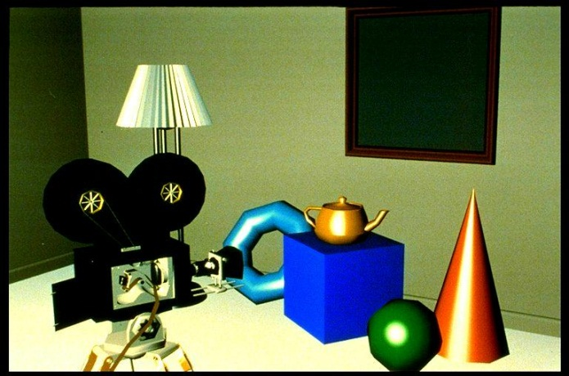
CONSTANT SHADING
Effects of different shading techniques
FACETED SHADING
INTERPOLATION SHADING
GOURAUD SHADING
PHONG SHADING
*
Computer Graphics
‹#›

Slide 8
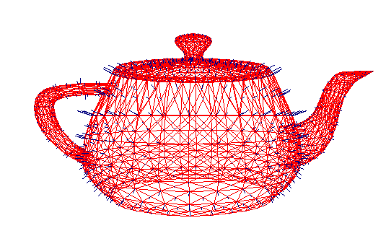
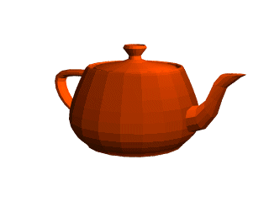
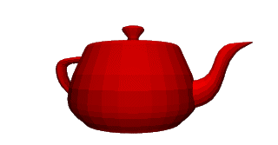
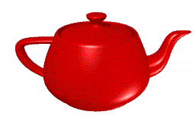
OBJECT MODEL
Effects of different shading techniques
FACETED SHADING
INTERPOLATION SHADING
GOURAUD SHADING
PHONG SHADING
*
Computer Graphics
‹#›

Slide 9
Shading Models
We will start to look at shading or rendering methods commonly used in computer graphics
Constant surface shading/rendering
Faceted surface shading/rendering
Gouraud surface shading/rendering
Phong surface shading/rendering
*
Computer Graphics
‹#›

Slide 10
Contents
Constant Intensity Shading
Faceted Shading
Gouraud Shading
Phong and Fast Phong Shading
Notes:
‹#›

Slide 11

Constant Intensity Shading
Constant intensity shading also refer to as no shading.
It is done by giving same color to every polygon in the object.
Thus entire object is painted with the same color.
It is the simplest, but not realistic.
*
Computer Graphics
‹#›

Slide 12
Contents
Constant Intensity Shading
Faceted Shading
Gouraud Shading
Phong and Fast Phong Shading
Notes:
‹#›

Slide 13

Faceted Shading
Also known as flat shading or fast shading it is an extension to Constant intensity shading.
The entire object is divided into number of polygons surfaces called facets.
Determine the orientation of each facet and does one color computation for each polygon or facet.
It is simple, fast (?) and produce better results than no shading.
*
Computer Graphics
‹#›

Slide 14
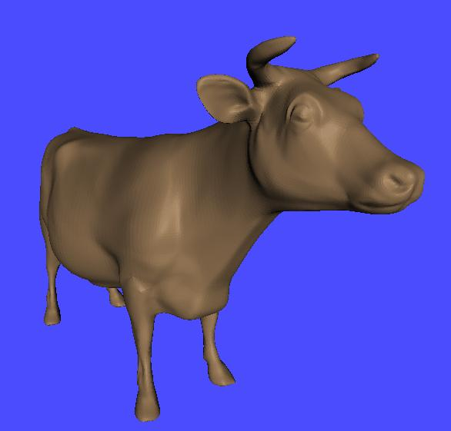
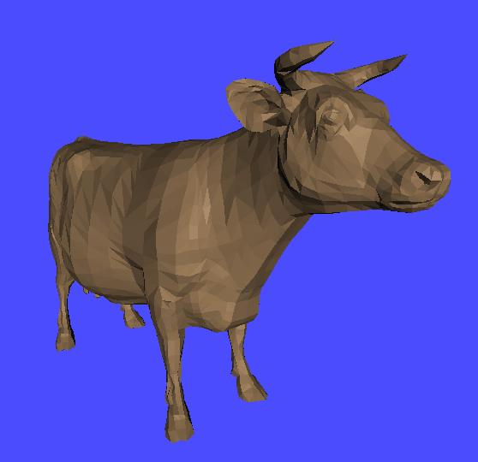
Faceted Shading
Original
Faceted Shaded
Just add lots and lots of polygons – however, this is SLOW!
*
Computer Graphics
‹#›

Slide 15
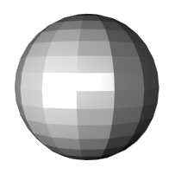
Faceted Shading
Still it is not realistic as
For point sources, the direction to light varies across the facet
For specular reflectance, direction to eye varies across the facet
We have to determine the orientation of each facet we have to find the normal for each facet. This approximation effect the result.
*
Computer Graphics
‹#›

Slide 16
Faceted Shading
To determine the orientation of each facet we introduce vertex normal at each vertex
Usually different from facet normal
Used only for shading
Think of as a better approximation of the real surface that the polygons approximate
*
Computer Graphics
‹#›

Slide 17
Faceted Shading
Vertex normals may be
Approximated by averaging the normals of the facets that share the vertex
Provided with the model
*
Computer Graphics
‹#›

Slide 18
Faceted Shading
It is very useful for quickly displaying the general appearance of surfaces
It is more applicable when
the object must be polyhedron and not an approximation of an object with a curved surface.
All light sources illuminating the object are sufficiently far from the surface so that N.L and the attenuation functions are constant over the surface.
The viewing position is sufficiently far from the surface so that V.R is constant over the surface.
*
Computer Graphics
‹#›

Slide 19
Contents
Constant Intensity Shading
Faceted Shading
Gouraud Shading
Phong and Fast Phong Shading
Notes:
‹#›

Slide 20
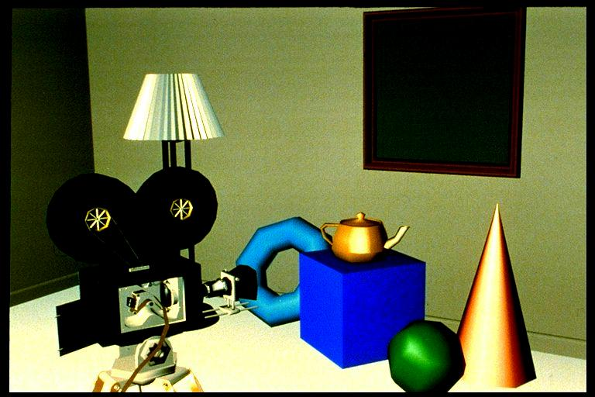
Gouraud Shading
Gouraud surface shading was developed in the 1970s by Henri Gouraud while working at the University of Utah along with Ivan Sutherland and David Evans
Often also called intensity-interpolation surface rendering
This is the most common approach
Intensity levels are calculated at each vertex
Linearly interpolate the resulting colors over faces
Along edges
Along scanlines
*
Computer Graphics
‹#›

Slide 21
Gouraud Shading
To render a polygon, Gouraud surface rendering proceeds as follows:
Determine the average unit normal vector at each vertex of the polygon
Apply an illumination model at each polygon vertex to obtain the light intensity at that position
Linearly interpolate the vertex intensities over the projected area of the polygon
*
Computer Graphics
‹#›

Slide 22
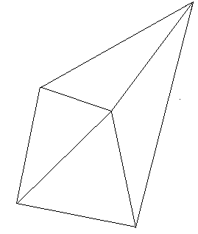
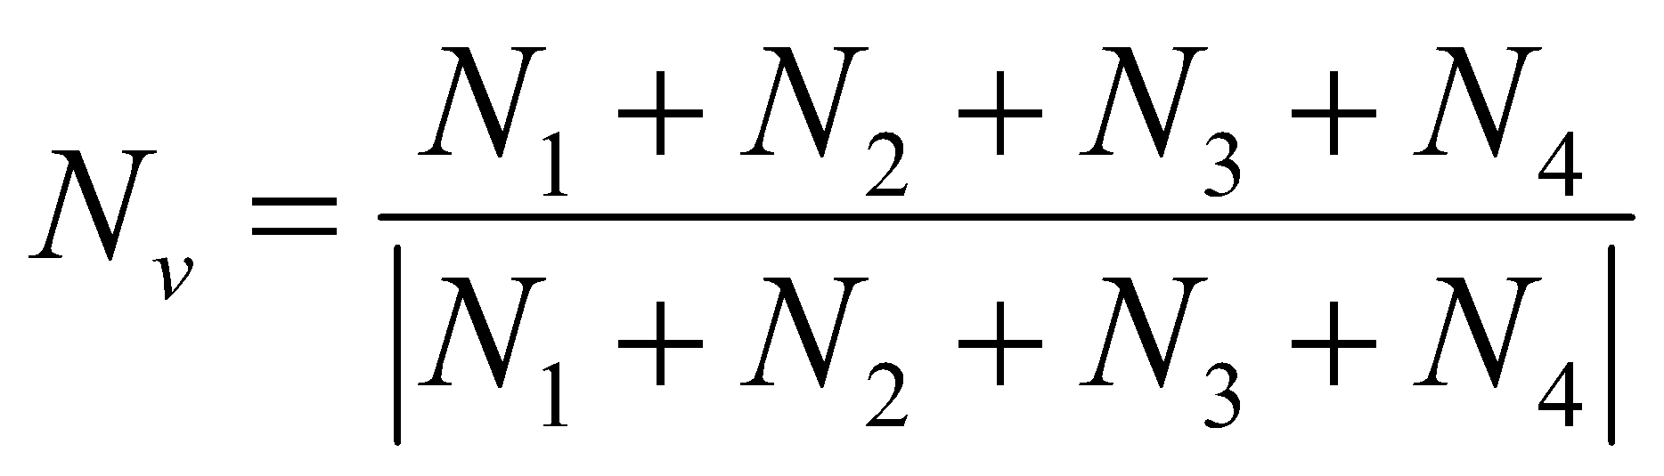
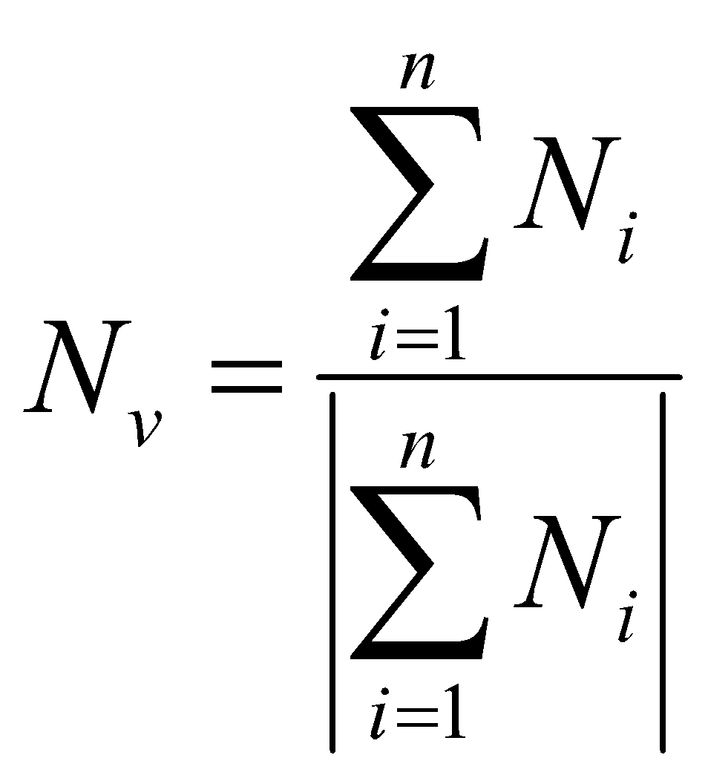
Gouraud Shading
Step 1: Determine the average unit normal vector at each vertex of the polygon
The average unit normal vector at v is given as:
or more generally:
N₁
N_{v}
v
N₄
N₂
N₃
*
Computer Graphics
‹#›

Slide 23
Gouraud Shading
Step 2: Apply an illumination model at each polygon vertex
I₂
You have to apply the illumination model to take of
ambient light
Diffuse reflection
Specular reflection
Transparency (Refraction)
N₁
I₁
N_{v}
I
v
N₄
N₂
N₃
I₄
I₃
*
Computer Graphics
‹#›

Slide 24
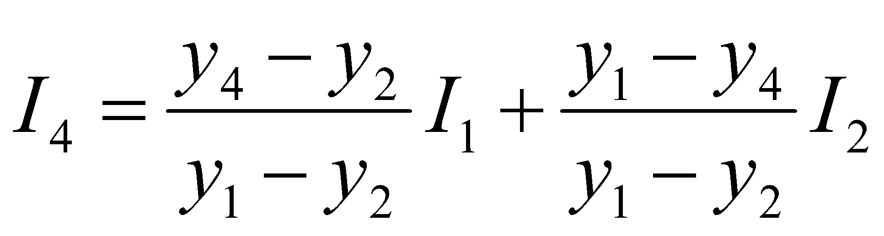
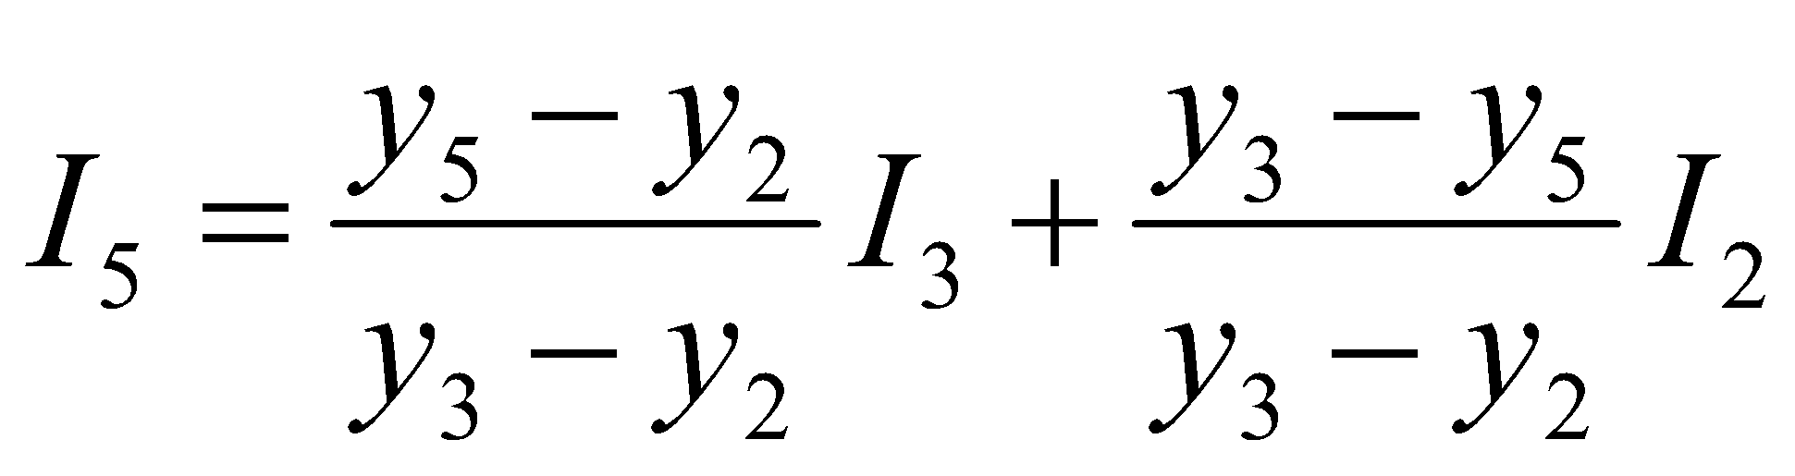
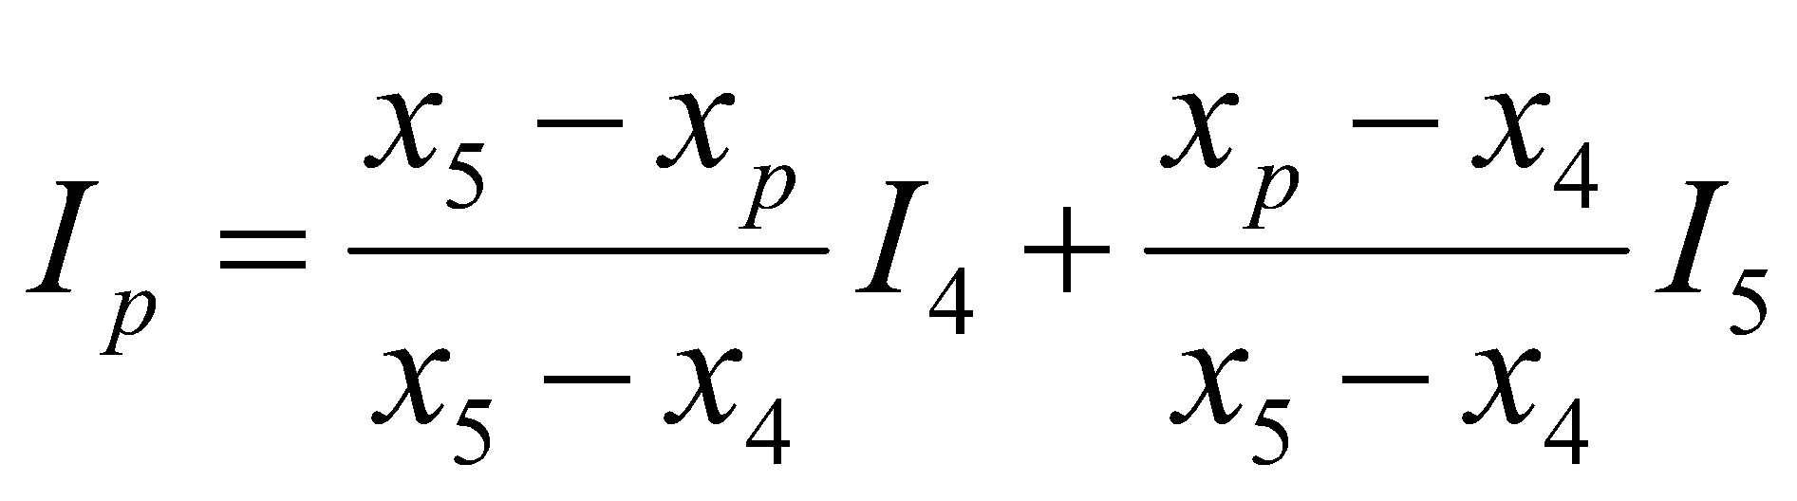
Gouraud Shading
Step 3: Linearly interpolate the vertex intensities over the projected area of
the polygon along edges and along scan lines
y
3
1
Scan-line
4
p
5
2
*
x
Computer Graphics
‹#›

Slide 25
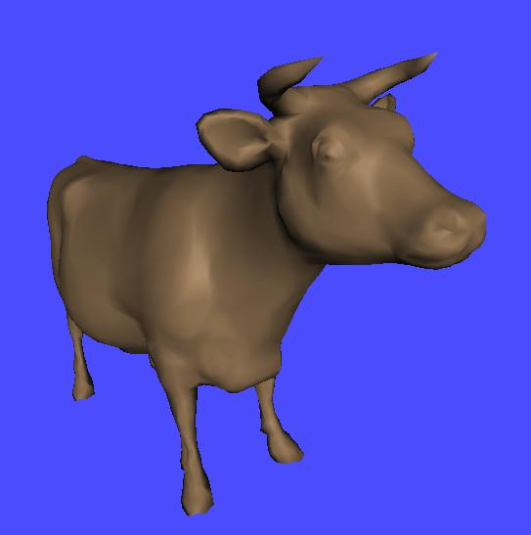
Gouraud Shading
Original
Gouraud Shaded
*
Computer Graphics
‹#›

Slide 26
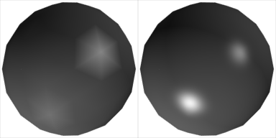
Gouraud Shading
Objects shaded with Gouraud shading often appears dull, chalky
Lacks accurate specular component
If included, will be averaged over entire polygon
C₁
C₃
C₂
Can’t shade that effect!
*
Computer Graphics
‹#›

Slide 27
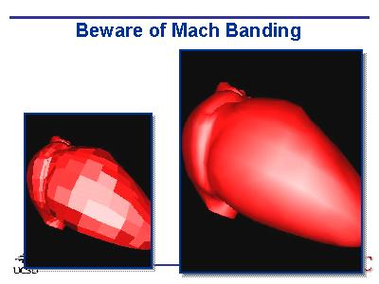
Gouraud Shading
Gouraud shading can introduce anomalies known as Mach bands
Mach banding
Artifact at discontinuities in intensity or intensity slope
C₁
C₄
C₃
C₂
Discontinuity in rate of color change occurs here
*
Computer Graphics
‹#›

Slide 28
Contents
Constant Intensity Shading
Faceted Shading
Gouraud Shading
Phong and Fast Phong Shading
Notes:
‹#›

Slide 29

Phong Shading
A more accurate interpolation based approach for rendering a polygon was developed by Phong Bui Tuong
Basically the Phong surface rendering model interpolates normal vectors instead of intensity values and then compute the actual intensity value using Phong Lighting Model.
Often also called normal or vector – interpolation surface rendering
*
Computer Graphics
‹#›

Slide 30
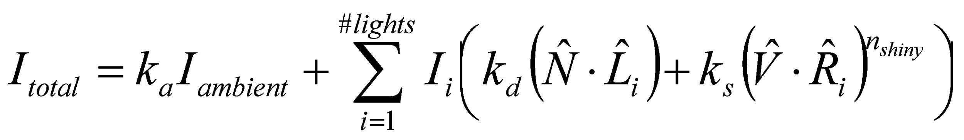
Phong Shading
Phong shading is not the same as Phong lighting, though they are sometimes mixed up
Phong lighting: the empirical model we’ve been discussing to calculate illumination at a point on a surface
Phong shading: linearly interpolating the surface normal across the facet, applying the Phong lighting model at every pixel
*
Computer Graphics
‹#›

Slide 31
Phong Shading
To render a polygon, Phong surface rendering proceeds as follows:
Determine the average unit normal vector at each vertex of the polygon
Linearly interpolate the vertex normals over the projected area of the polygon
Apply an illumination model at positions along scan lines to calculate pixel intensities using the interpolated normal vectors
*
Computer Graphics
‹#›

Slide 32
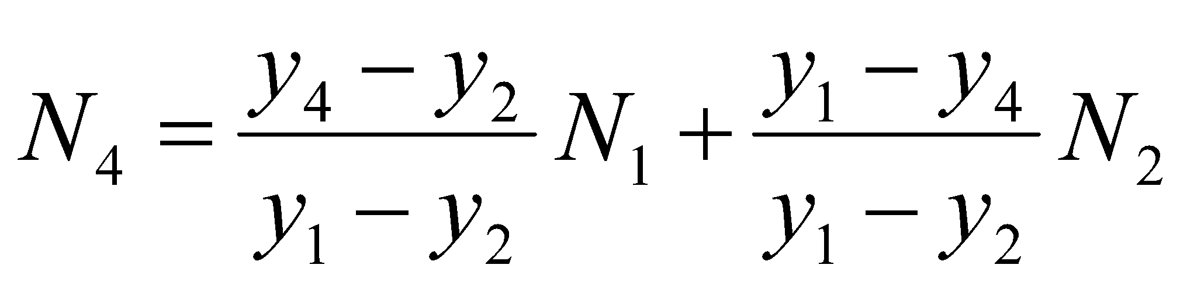
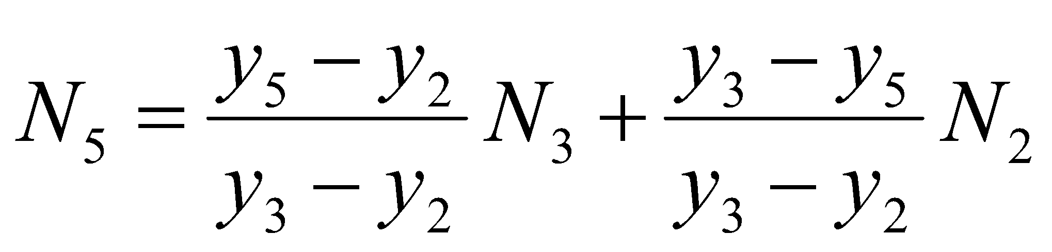
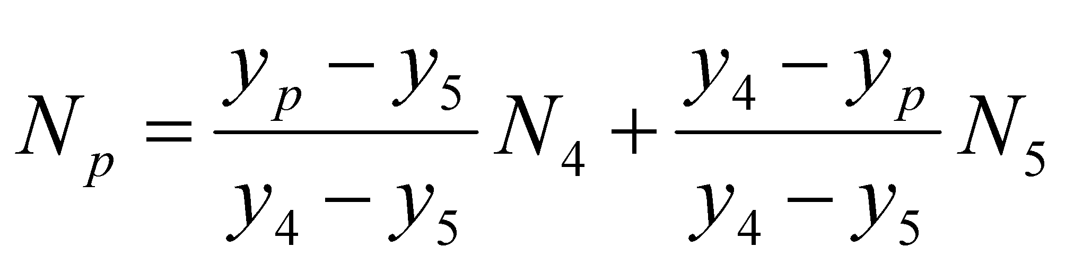
Phong Shading
Interpolating Normal
N₃
N₁
N₄
N_{p}
Scan line
p
N₅
N₂
*
Computer Graphics
‹#›

Slide 33
Phong Shading
Phong shading accept the same input as Gouraud shading and produce very smooth-looking results.
Phong shading is considerably more expensive.
Phong shading is much slower than Gouraud shading as the lighting model is revaluated so many times
However, there are fast Phong surface rendering approaches that can be implemented iteratively.
*
Computer Graphics
‹#›

Slide 34
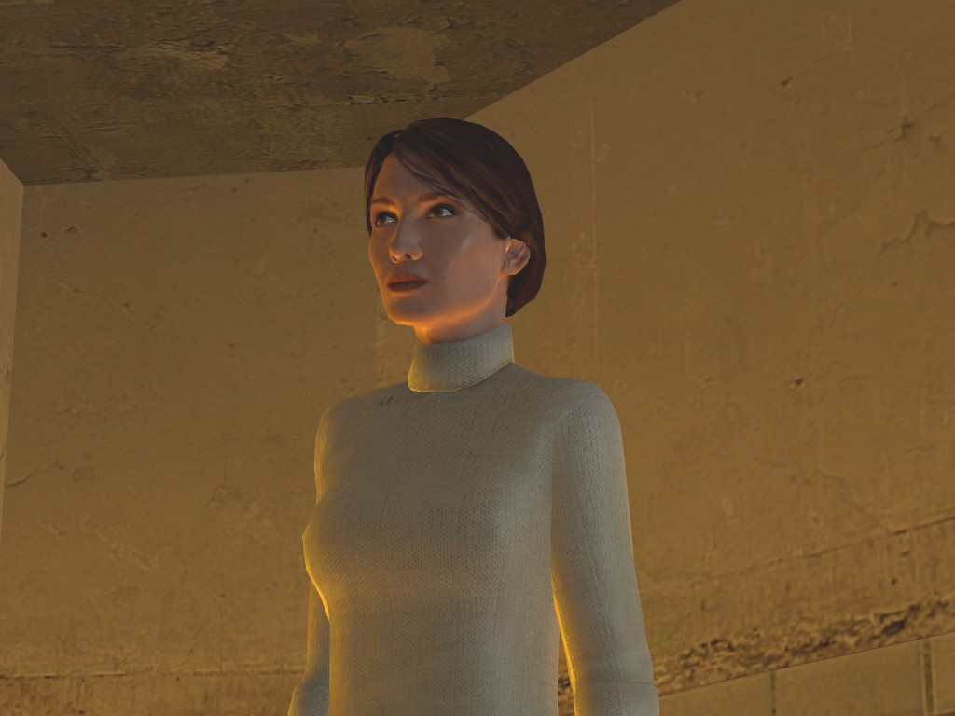
Phong Shading Examples
*
Computer Graphics
‹#›

Slide 35
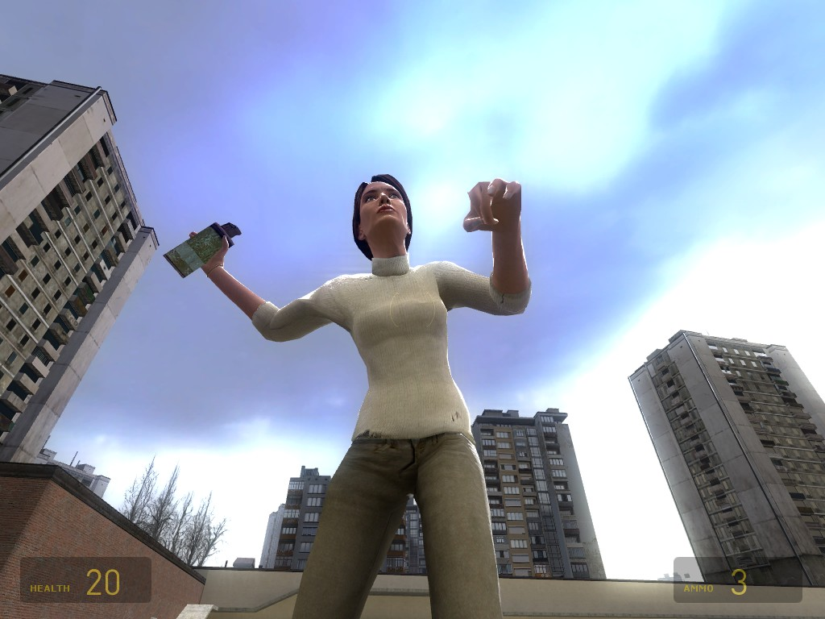
Phong Shading Examples
*
Computer Graphics
‹#›

Slide 36
Summary
For realistic rendering of polygons we need interpolation methods to determine lighting positions
Flat shading is fast, but unrealistic
Gouraud shading is better, but does not handle specular reflections very well
Phong shading is better still, but can be slow
*
Computer Graphics
‹#›

